Slide 1
Cyber Security
UNIT - I
Introduction of Cybercrime
K. BALAKRISHNA
B.Tech., MBA., M.TECH., DID., (Ph.D)

Slide 2
TOPICS
Definition and Origins of the Word
Cybercrime and Information Security
Who are Cybercriminals?
Classifications of Cybercrimes
Cybercrime Era: Survival mantra for the Netizens

Slide 3
Definition and Origins of the Word
The internet in India is growing rapidly. It has given rise to new opportunities in every field we can think of be it entertainment, business, sports or education.
There’re two sides to a coin. Internet also has it’s own disadvantages. One is Cyber crime- illegal activity committed on the internet.
In 1820, JosephMarie Jacquard, a textile manufacturer in France, produced the loom. This device allowed the repetition of a series of steps in the weaving of special fabrics. This resulted in a fear amongst Jacquard's employees that their traditional employment and livelihood were being threatened. They committed acts of sabotage to discourage Jacquard from further use of the new technology. This is the first recorded cyber crime!

Slide 4
What is cybercrime?
Any illegal act where a special knowledge of computer technology is essential for its perpetration, investigation or prosecution.
Any traditional crime that has acquired a new dimension or order of magnitude through the aid of a computer, and abuses that have come into being because of computers.
Any financial dishonesty that takes place in a computer environment.
Any threats to the computer itself, such as theft of hardware or software, sabotage and demands for ransom.
“Cybercrime (computer crime) is any illegal behavior, directed by means of electronic operations, that target the security of computer systems and the data processed by them”.
Hence all criminal activities done using the medium of computers, the Internet, cyberspace and the WWW. Cybercrime can sometimes be called as computer-related crime, computer crime, E-crime, Internet crime, High-tech crime….

Slide 5
Types of attacks
Techno - crime : Active attack
Techno Crime is the term used by law enforcement agencies to denote criminal activity which uses (computer) technology, not as a tool to commit the crime, but as the subject of the crime itself. Techno Crime is usually pre-meditated and results in the deletion, corruption, alteration, theft or copying of data on an organization's systems.
Techno Criminals will usually probe their prey system for weaknesses and will almost always leave an electronic 'calling card' to ensure that their pseudonym identity is known.
Techno – vandalism: Passive attack
Techno Vandalism is a term used to describe a hacker or cracker who breaks into a computer system with the sole intent of defacing and or destroying its contents.
Techno Vandals can deploy 'sniffers' on the Internet to locate soft (insecure) targets and then execute a range of commands using a variety of protocols towards a range of ports. If this sounds complex - it is! The best weapon against such attacks is a firewall which will hide and disguise your organization's presence on the Internet.

Slide 6
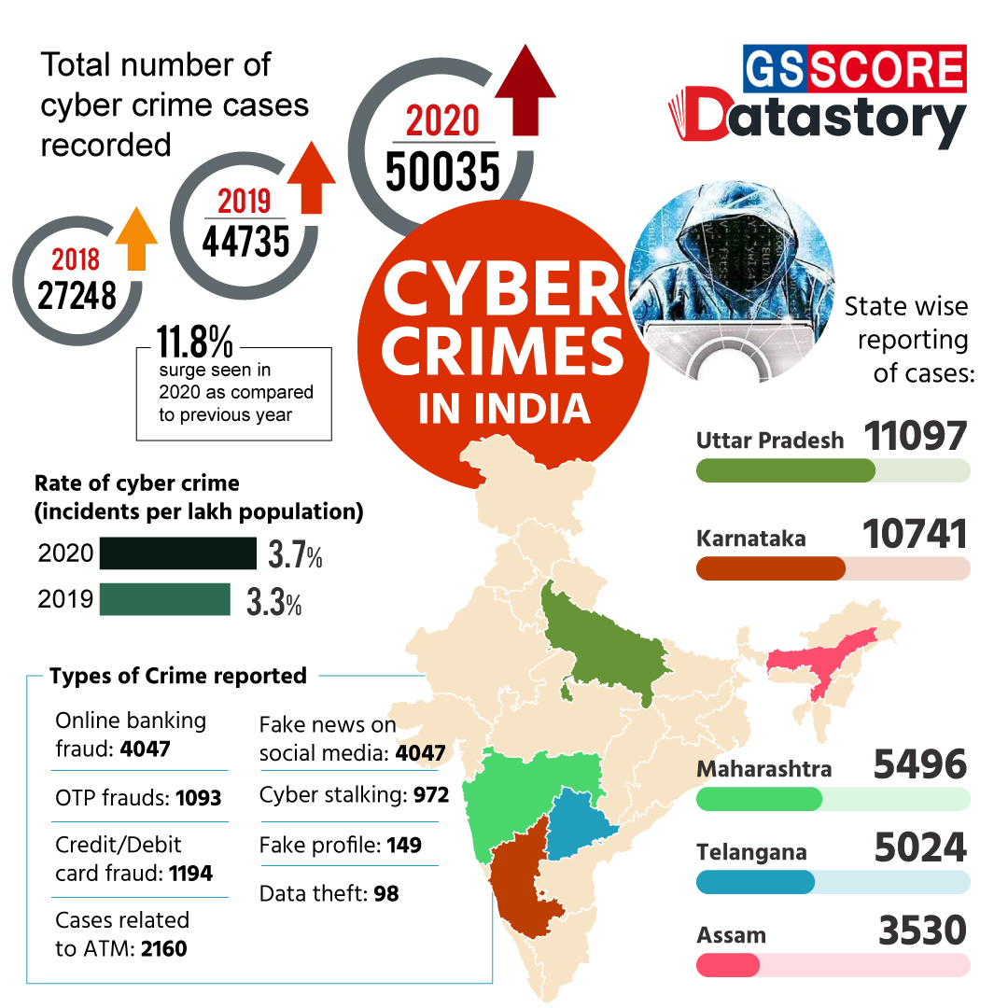

Slide 7
2. Cybercrime and information security
Lack of information security gives rise to cybercrime!
Cyber Security means protecting information, equipment, devices, computer, computer resource, communication device and information stored therein from unauthorized access, use, disclosure, disruption, modification or destruction.
Challenges for securing data in business perspective:
Cybercrimes occupy an important space in information security due to their impact.
Most organizations do not incorporate the cost of the vast majority of computer security incidents into their accounting
The difficulty in attaching a quantifiable monetary value to the corporate data and yet corporate data get stolen/lost
Financial loses may not be detected by the victimized organization in case of Insider attacks such as leaking customer data.

Slide 8
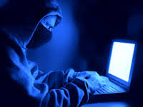
3. Who are Cybercriminals
Are those who conduct acts such as:
Child pornography
Credit card fraud
Cyberstalking
Defaming another online
Gaining unauthorized access to computer systems
Ignoring copyrights
Software licensing and trademark protection
Overriding encryption to make illegal copies
Software piracy
Stealing another’s identity to perform criminal acts

Slide 9

Categorization of Cybercriminals
Type 1: Cybercriminals - Hungry for recognition:
Hobby hackers
A person who enjoys exploring the limits of what is possible, in a spirit of playful cleverness. May modify hardware/ software.
IT professional(social engineering):
Ethical hacker
Politically motivated hackers :
Promotes the objectives of individuals, groups or nations supporting a variety of causes such as : Anti globalization, transnational conflicts and protest.
Terrorist organizations
Cyber Terrorism
Use the internet attacks in terrorist activity
Large scale disruption of computer networks , personal computers attached to internet via viruses

Slide 10
Categorization of Cybercriminals
Type 2: Cybercriminals - Not interested in recognition!
Psychological perverts
Express sexual desires, deviates from normal behavior
Poonam panday
Financially motivated hackers
Make money from cyber attacks
Bots-for-hire : fraud through phishing, information theft, spam and extortion
State-sponsored hacking
Hacktivists
Extremely professional groups working for governments
Have ability to worm into the networks of the media, major corporations, defense departments

Slide 11
Categorization of Cybercriminals
Type 3: Cybercriminals - the insiders
Disgruntled former employees seeking revenge
Competing companies using employees to gain economic advantage through damage and/ or theft.
Motives behind cybercrime:
Greed
Desire to gain power
Publicity
Desire for revenge
A sense of adventure
Looking for thrill to access forbidden information
Destructive mindset
Desire to sell network security services

Slide 12
4. Classification of cybercrimes
Cybercrime against an individual
Cybercrime against property
Cybercrime against organization
Cybercrime against Society
Crimes emanating from Usenet newsgroup

Slide 13
a. Cybercrime against an individual:
Electronic mail spoofing and other online frauds
Phishing, spear phishing
Spamming
Cyberdefamation
Cyberstalking and harassment
Computer sabotage
Pornographic offenses
Password Sniffing
b. Cybercrime against property:
Credit card frauds
Intellectual property( IP) crimes
Internet time theft

Slide 14
c. Cybercrime against organization:
Unauthorized accessing of computer
Password sniffing
Denial-of-service attacks
Virus attack/dissemination of viruses
E-Mail bombing/mail bombs
Salami attack/ Salami technique
Logic bomb
Trojan Horse
Data diddling
Industrial spying/ industrial espionage
Computer network intrusions
Software piracy

Slide 15
d. Cybercrime against Society:
Forgery
Cyber Terrorism
Web jacking
e. Crimes emanating from Usenet newsgroup:
Usenet groups may carry very offensive, harmful, inaccurate material
Postings that have been mislabeled or are deceptive in another way
Hence service at your own risk

Slide 16
History of Usenet groups
In 1979 it was developed by two graduate students from Duke University in North Carolina (UNC) as a network that allowed users to exchange quantities of information too large for mailboxes.
Usenet was designed to facilitate textual exchanges between scholars.
Slowly, the network structure adapted to allow the exchange of larger files such as videos or images.
Usenet newsgroups constitute one of the largest source of child pornography available in cyberspace.
This source useful for observing other types of criminal or particular activities: online interaction between pedophiles, adult pornographers and writers of pornographic stories.
Usenet for sharing illegal content.

Slide 17
E-Mail Spoofing
A spoofed email is one in which the e-mail header is forged so that the mail appears to originate from one source but actually has been sent from another source. i.e., It is the forgery of an e-mail header so that the message appears to have originated from someone or somewhere other than the actual source.
To send spoofed e-mail, senders insert commands in headers that will alter message information.
It is possible to send a message that appears to be from anyone, anywhere, saying whatever the sender wants it to say.
Thus, someone could send spoofed e-mail that appears to be from you with a message that you didn't write.
Classic examples of senders who might prefer to disguise the source of the e-mail include a sender reporting mistreatment by a spouse to a welfare agency.

Slide 18
E-Mail Spoofing
Although most spoofed e-mail falls into the "nuisance" category and requires little action other than deletion, the more malicious varieties can cause serious problems and security risks.
For example, spoofed e-mail may purport to be from someone in a position of authority, asking for sensitive data, such as passwords, credit card numbers, or other personal information -- any of which can be used for a variety of criminal purposes.
The Bank of America, eBay, and Wells Fargo are among the companies recently spoofed in mass spam mailings.
One type of e-mail spoofing, self-sending spam, involves messages that appear to be both to and from the recipient.

Slide 19
SPAMMING
People who create electronic spam : spammers
Spam is abuse of electronic messaging systems to send unsolicited bulk messages or mass e-mails such as chain letters indiscriminately.
Spamming may be:
E-Mail Spam
Instant messaging spam
Usenet group spam
Web search engine spam
Spam in blogs, wiki spam
Online classified ads spam
Mobile phone messaging spam
Internet forum spam
Junk fax spam
Social networking spam

Slide 20
SPAMMING
Spamming is difficult to control
Advertisers have no operating costs beyond the management of their mailing lists
It is difficult to hold senders accountable for their mass mailings
Spammers are numerous
Search engine spamming:
Alteration or creation of a document with the intent to deceive an electronic catalog or a filing system
some web authors use “subversive techniques” to ensure that their site appears more frequently or higher number in returned search results.
Remedy: permanently exclude from the search index

Slide 21
Cyber defamation

Slide 22
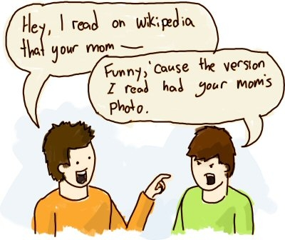
Cyber defamation
Cyber defamation, also known as online defamation, is when someone is falsely accused of something online. Cyber defamation is the use of the internet or a computer to damage another person's reputation or diminish one's own reputation in the eyes of others.
Example: someone publishes defamatory matter about someone on a website or sends an E-mail containing defamatory information to all friends of that person.

Slide 23
Cyber defamation
It may amount to defamation when-
If imputation to a deceased person would harm the reputation of that person, and is intended to be hurtful to the feelings of his family or other near relatives.
An imputation is made concerning a company or an association or collection of people as such.
An imputation in the form of an alternative or expressed ironically.
An imputation that directly or indirectly, in the estimation of others, lowers the moral or intellectual character of that person, or lowers the character of that person in respect of his caste or of his calling, or lowers the credit of that person.

Slide 24
Cyber defamation
Saying or writing something harmful to a person’s reputation is defamation. It’s against the law to intentionally harm someone’s reputation, cause them to be hated or disgraced through text, image, cartoons, caricatures or effigies.
Types of defamation:
Libel : written defamation
Libel involves something that is visually represented, with the intention to harm someone’s reputation, and which can be seen. So, anything that can be written, printed or something on an effigy, movie or statue can be libel. If Rahul writes something about Seema in a magazine in a derogatory manner, then Rahul has committed the crime of defamation through libel.
Slander: oral defamation
Slander involves something that is spoken, with the intention to harm someone’s reputation, and which can be heard. It is in verbal form. For example, Rahul says bad things about Seema’s character, which results in Seema losing her job. Rahul has committed the crime of defamation through slander.

Slide 25
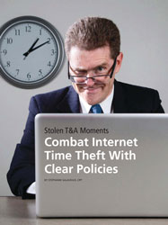
Internet Time Theft
Hacking the username and password of ISP of an individual and surfing the internet at his cost is Internet Time Theft.
The person get access to someone else’s ISP user ID and password, either by hacking or by gaining access to it by illegal means and uses the internet without the other person’s knowledge.
This theft can be identified when Internet time is recharged often, despite infrequent usage.
This comes under “identity theft”.

Slide 26
Salami attack/ salami technique
It is an attack which proceeds with small increments and final add up to lead to a major attack. The increments are so small that they remain unnoticed.
An example of salami attack is gaining access to online banking of an individual and withdrawing amount in such a small amounts that it remains unnoticed by the owner. Often there is default trigger set in the banking website and transactions below say, Rs. 1000 withdrawal are not reported to the owner of the account. Withdrawing amount of Rs. 1000 over a period of time will lead to total withdrawal of a large sum.
Examples:
Small “shavings” for Big gains!
The petrol pump fraud

Slide 27
Data diddling
Data diddling involves changing data input in a computer. In other words, information is changed from the way it should be entered by a person typing in the data. Usually, a virus that changes data or a programmer of the database or application has pre-programmed it to be changed.
A cybercrime where a person intentionally enters wrong information into a computer, system, or document. It is often used when businesses and individuals want to hide part of their profits for tax evasion purposes.
To deal with this type of crime, a company must implement policies and internal controls.
This may include performing regular audits, using software with built-in features to combat such problems, and supervising employees.
Ex: Electricity board in India have been victims to data diddling programs inserted when private parties computerized their systems.

Slide 28
Forgery
The act of forging something, especially the unlawful act of counterfeiting a document or object for the purposes of fraud or deception.
Something that has been forged, especially a document that has been copied or remade to look like the original.
Counterfeit currency notes, postage, revenue stamps, mark sheets, etc., can be forged using sophisticated computers, printers and scanners.
Real life case:
Stamp Paper Scam – a racket that flourished on loopholes in the system
Abdul Karim Telgi, the mastermind of the multi-crore counterfeiting, printed fake stamp papers worth thousands of crores of rupees using printing machines purchased illegally with the help of some conniving officials of the Central Govt.’s Security Printing Press (India Security Press) located in Nasik. These fake stamp papers penetrated in more than 12 states through a widespread network of vendors who sold the counterfeits without any fear and earned hefty commissions.
Amount swindled Rs. 172 crores
Telgi is in jail serving his 13 plus 10 years term

Slide 29

Web jacking
This term is derived from the term hi jacking.
In these kinds of offences the hacker gains access and control over the web site of another. He may even change the information on the site.
The first stage of this crime involves “password sniffing”.
The actual owner of the website does not have any more control over what appears on that website
This may be done for fulfilling political objectives or for money.
Real Life Examples:
Recently the site of MIT (Ministry of Information Technology) was hacked by the Pakistani hackers and some obscene matter was placed therein.
Further the site of Bombay crime branch was also web jacked.
Another case of web jacking is that of the ‘gold fish’ case. In this case the site was hacked and the information pertaining to gold fish was changed.

Slide 30
Industrial spying/ Industrial Espionage
Industrial espionage is the covert and sometimes illegal practice of investigating competitors to gain a business advantage. The target of investigation might be a trade secret such as a proprietary product specification or formula, or information about business plans.
In many cases, industrial spies are simply seeking any data that their organization can exploit to its advantage.
Real Life Cases:
A Chinese Trojan horse email campaign targeted some 140 senior Israeli defense corporation employees (2013) involved in highly classified, sensitive security projects. The email was made to appear as if it came from a known German company that regularly works with the Israeli defense industry.
However, it turned out to contain a Trojan horse, which, according to the report, attempted to funnel information from the recipients' computers. The Trojan horse was noticed by computer defense systems and shut down.
The defense establishment then realized how many Israelis received the email, and reportedly tracked the malicious program down to Chinese defense industries. The incident led security companies to reiterate to employees computer security guidelines.

Slide 31
Hacking
Every act committed towards breaking into a computer and/ or network is called hacking.
Purpose of hacking:
Greed
Power
Publicity
Revenge
Adventure
Desire to access forbidden information
Destructive mindset

Slide 32
Hacking
Hacking is any technical effort to manipulate the normal behavior of network connections and connected systems.
A hacker is any person engaged in hacking.
The term "hacking" historically referred to constructive, clever technical work that was not necessarily related to computer systems.
M.I.T. engineers in the 1950s and 1960s first popularized the term and concept of hacking.
The so-called "hacks" perpetrated by these hackers were intended to be harmless technical experiments and fun learning activities.
Later, outside of M.I.T., others began applying the term to less honorable pursuits. For example, several hackers in the U.S. experimented with methods to modify telephones for making free long-distance calls over the phone network illegally.
As computer networking and the Internet exploded in popularity, data networks became by far the most common target of hackers and hacking.

Slide 33
Hacking vs. Cracking
Hacking is the act of compromising digital devices to gain unauthorized access. Although the media commonly uses the term “hacking” to refer to illegal activities, people in the hacking community generally consider themselves the good guys, while crackers are the bad guys.
This is because, in the hacking community, the goal of hacking is to improve or alter security systems and programs.
Cracking is a technique that is used to break into computer software, systems, or networks with malicious intent. In the same way that a bank robber might crack a safe, a “cracker” breaks into a digital device or program.
There are several types of cracking, and crackers employ many different techniques to break into computer systems and software. However, the three most common forms of cracking are password cracking, software cracking, and web cracking.

Slide 34
Hacker | Cracker
The good people who hack for knowledge purposes. | The evil person who breaks into a system for benefits.
They are skilled and have advanced knowledge of computers OS and programming languages. | They may or may not be skilled, some crackers just know a few tricks to steal data.
They work in an organization to help protect their data and give them expertise in internet security. | These are the person from which hackers protect organizations.
Hackers share the knowledge and never damages the data. | If they found any loophole they just delete the data or damages the data.
Hackers are the ethical professionals. | Crackers are unethical and want to benefit themselves from illegal tasks.
Hackers program or hacks to check the integrity and vulnerability strength of a network. | Crackers do not make new tools but use someone else tools for their cause and harm the network.
Hackers have legal certificates with them e.g CEH certificates. | Crackers may or may not have certificates, as their motive is to stay anonymous.
They are known as White hats or saviors. | They are known as Black hats or evildoers.

Slide 35
types of modern hackers
Hackers fall into three general categories: black hat hackers, white hat hackers, and gray hat hackers. Although hackers are often associated with exploiting vulnerabilities to gain unauthorized access to computers, systems, or networks, not all hacking is malicious or illegal. In its purest sense, hacking is simply the application of computer skills to solve a particular problem.
Black hat hackers:
Black hat hackers are cybercriminals that illegally crack systems with malicious intent. Seeking to gain unauthorized access to computer systems is the definition of black hat hacking. Once a black hat hacker finds a security vulnerability, they try to exploit it, often by implanting a virus or other type of malware such as a trojan.
White hat hackers:
White hat hackers are ethical security hackers who identify and fix vulnerabilities. Hacking into systems with the permission of the organizations they hack into, white hat hackers try to uncover system weaknesses in order to fix them and help strengthen a system’s overall security.

Slide 36
types of modern hackers
Gray hat hackers:
Gray hat hackers may not have the criminal or malicious intent of a black hat hacker, but they also don’t have the prior knowledge or consent of those whose systems they hack into. Nevertheless, when gray hat hackers uncover weaknesses such as zero-day vulnerabilities, they report them rather than fully exploiting them. But gray hat hackers may demand payment in exchange for providing full details of what they uncovered.
Other types of hackers:
Although nearly all hackers fall into one of the three categories (black hat, white hat, or gray hat), there are other types and sub-types of hackers.
Green hat hackers: Green hat hackers are “green” in the sense that they’re inexperienced and may lack the technical skills of more experienced hackers. Green hats may rely on phishing and other social engineering techniques to bypass security systems.
Blue hat hackers: Blue hat hackers are white hat hackers who are actually employed by an organization to help improve their security systems by conducting penetration tests.
Red hat hackers: Also known as vigilante hackers, red hat hackers are motivated by a desire to fight back against black hat hackers, but they do this by infiltrating black hat communities on the dark web and launching hacking attacks against their networks and devices.

Slide 37
Real life case : dec 2009 NASA site hacked via SQL Injection
Two NASA sites recently were hacked by an individual wanting to demonstrate that the sites are susceptible to SQL injection.
The websites for NASA's Instrument Systems and Technology Division and Software Engineering Division were accessed by a researcher, who posted to his blog screen shots taken during the hack.
The researcher, using the alias "c0de.breaker," used SQL injection to hijack the sites.
SQL injection is an attack process where a hacker adds additional SQL code commands to a page request and the web server then tries to execute those commands within the backend database
The NASA hack yielded the credentials of some 25 administrator accounts.
The researcher also gained access to a web portal used for managing and editing those websites.
In this particular case, the researcher found the vulnerabilities, made NASA aware of them, then published findings after the websites had been fixed.
An attacker, however, could have tried to use that web server as an entry point into other systems NASA might control or edit the content of the sites and use them for drive-by downloads.

Slide 38
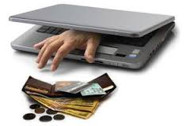
Online frauds
Fraud that is committed using the internet is “online fraud.” Online fraud can involve financial fraud and identity theft.
Online fraud comes in many forms.
viruses that attack computers with the goal of retrieving personal information, to email schemes that lure victims into wiring money to fraudulent sources,
“phishing” emails that purport to be from official entities (such as banks or the Internal Revenue Service) that solicit personal information from victims to be used to commit identity theft,
to fraud on online auction sites (such as Ebay) where perpetrators sell fictional goods.
E-Mail spoofing to make the user to enter the personal information : financial fraud
Illegal intrusion: log-in to a computer illegally by having previously obtained actual password. Creates a new identity fooling the computer that the hacker is the genuine operator. Hacker commits innumerable number of frauds.

Slide 39
Pornographic offenses: Child pornography
Means any visual depiction, including but not limited to the following:
Any photograph that can be considered obscene and/ or unsuitable for the age of child viewer.
Film ,video, picture;
Obscene Computer generated image or picture

Slide 40
How do they Operate
Pedophiles use false identity to trap the children/teenagers
Pedophiles contact children/teens in various chat rooms which are used by children/teen to interact with other children/teen.
Befriend the child/teen.
Extract personal information from the child/teen by winning his confidence.
Gets the e-mail address of the child/teen and starts making contacts on the victims e-mail address as well.
Starts sending pornographic images/text to the victim including child pornographic images in order to help child/teen shed his inhibitions so that a feeling is created in the mind of the victim that what is being fed to him is normal and that everybody does it.
Extract personal information from child/teen
At the end of it, the pedophile set up a meeting with the child/teen out of the house and then drag him into the net to further sexually assault him or to use him as a sex object.

Slide 41

Software piracy
Theft of software through the illegal copying of genuine programs or the counterfeiting and distribution of products intended to pass for the original.
End-user copying
Hard disk loading with illicit means
Counterfeiting
Illegal downloads from internet
Buying Pirated software have a lot to lose:
Getting untested software that may have been copied thousands of times.
Potentially contain hard-ware infecting viruses
No technical support in case of software failure
No warranty protection
No legal right to use the product

Slide 42

Computer sabotage
Computer sabotage involves deliberate attacks intended to disable computers or networks for the purpose of disrupting commerce, education and recreation for personal gain, committing espionage, or facilitating criminal conspiracies through viruses, worms, logic bombs.
Chernobyl virus
The Chernobyl virus is a computer virus with a potentially devastating payload that destroys all computer data when an infected file is executed.,
Y2K virus
Y2K bug, also called Year 2000 bug or Millennium Bug, a problem in the coding of computerized systems that was projected to create havoc in computers and computer networks around the world at the beginning of the year 2000.

Slide 43

E-mail bombing/mail bombs
In Internet usage, an email bomb is a form of net abuse consisting of sending huge volumes of email to an address in an attempt to overflow the mailbox or overwhelm the server where the email address is hosted in a denial-of-service attack.
Construct a computer to repeatedly send E-mail to a specified person’s E-mail address.
Can overwhelm the recipient’s personal account and potentially shut down the entire system.

Slide 44

Computer network intrusions
An intrusion to computer network from any where in the world and steal data, plant viruses, create backdoors, insert trojan horse or change passwords and user names.
An intrusion detection system (IDS) inspects all inbound and outbound network activity and identifies suspicious patterns that may indicate a network or system attack from someone attempting to break into or compromise a system.

Slide 45
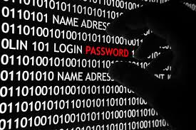
Password sniffing
Password sniffers are programs that monitor and record the name and password of network users as they login, jeopardizing security at a site.
Through sniffers installed, anyone can impersonate an authorized user and login to access restricted documents.

Slide 46
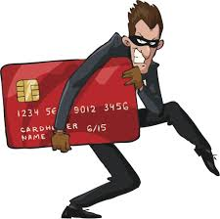
Credit card frauds
Credit card fraud is a wide-ranging term for theft and fraud committed using or involving a payment card, such as a credit card or debit card, as a fraudulent source of funds in a transaction.
The purpose may be to obtain goods without paying, or to obtain unauthorized funds from an account.
Credit card fraud is also an adjunct to identity theft.

Slide 47
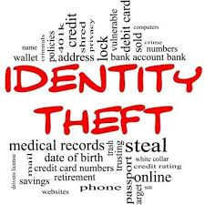
Identity theft
Identity theft is a fraud involving another person’s identity for an illicit purpose.
The criminal uses someone else’s identity for his/ her own illegal purposes.
Phishing and identity theft are related offenses.
Examples:
Fraudulently obtaining credit
Stealing money from victim’s bank account
Using victim’s credit card number
Establishing accounts with utility companies
Renting an apartment
Filing bankruptcy using the victim’s name

Slide 48
Real life cases
Dr. Gerald Barnes Gerald Barnbaum lost his pharmacist license after committing Medical fraud. He stole the identity of Dr. Gerald Barnes and practiced medicine under his name. A type 1 diabetic died under his care. “Dr. Barnes” even worked as a staff physician for a center that gave exams to FBI agents. He’s currently serving hard time.
Andrea Harris-Frazier Margot Somerville lost her wallet on a trolley. Two years later she was arrested. Andrea Harris-Frazier had defrauded several banks—using Somerville’s identity—out of tens of thousands of dollars. The real crook was caught.
Abraham Abdallah A busboy named Abraham Abdallah got into the bank accounts of Steven Spielberg and other famous people after tricking his victims via computer, getting sufficient data to fake being their financial advisors—then calling their banks…and you know the rest.

Slide 49
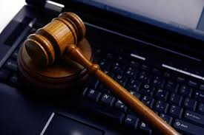
Cybercrime: the legal perspective
Cybercrime possess a mammoth challenge
Computer crime: Criminal Justice Resource Manual(1979)
Any illegal act for which knowledge of computer technology is essential for a successful prosecution.
International legal aspects of computer crimes were studied in 1983
Encompasses any illegal act for which the knowledge of computer technology is essential for its perpetration.

Slide 50
Cybercrime: the legal perspective
The network context of cyber crime make it one of the most globalized offenses of the present and most modernized threats of the future.
Solution:
Divide information system into segments bordered by state boundaries.
Not possible and unrealistic because of globalization
Or incorporate the legal system into an integrated entity obliterating these state boundaries.

Slide 51
Cybercrime: INDIAN perspective
India has the fourth highest number of internet users in the world.
45% of the population are internet users in India
37% - in cyber cafes
57% are between 18 and 35 years
The Information Technology (IT) Act, 2000, specifies the acts which are punishable. Since the primary objective of this Act is to create an enabling environment for commercial use of I.T.
217 cases were registered under IT Act during the year 2007 as compared to 142 cases during the previous year (2006) thereby reporting an increase of 52.8% in 2007 over 2006.
22.3% cases (49out of 217 cases) were reported from Maharashtra followed by Karnataka (40), Kerala (38) and Andhra Pradesh and Rajasthan (16 each).

Slide 52
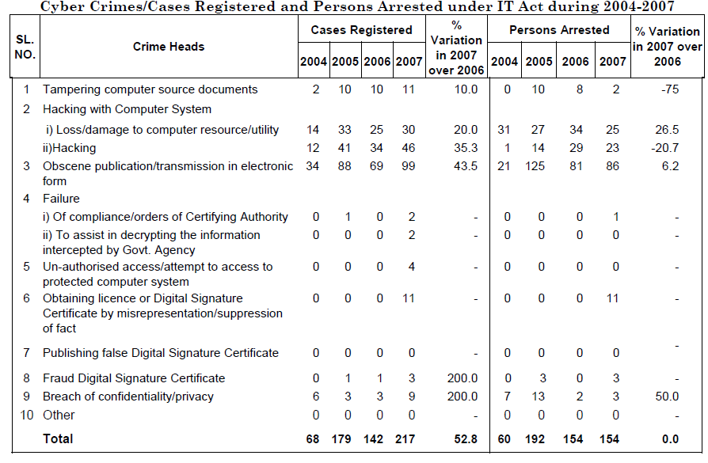

Slide 53
Incidence of Cyber Crimes in Cities
17 out of 35 mega cities did not report any case of Cyber Crime i.e, neither under the IT Act nor under IPC Sections) during the year 2007.
17 mega cities have reported 118 cases under IT Act and 7 megacities reported 180 cases under various section of IPC.
There was an increase of 32.6% (from 89 cases in 2006 to 118 cases in 2007) in cases under IT Act as compared to previous year (2006),
and an increase of 26.8% (from 142 cases in 2006 to 180 cases in 2007) of cases registered under various section of IPC
Bengaluru (40), Pune (14) and Delhi (10) cities have reported high incidence of cases (64 out of 118 cases) registered under IT Act, accounting for more than half of the cases (54.2%) reported under the Act.

Slide 54
5. CYBERCRIME ERA: SURVIVAL MANTRA FOR THE NETIZENS
The term “Netizen” was coined by Michael Hauben. Quite simply, “Netizens” are the Internet users. Therefore, by corollary, “Netizen” is someone who spends considerable time online and also has a considerable presence online (through websites about the person, through his/her active blog contribution and/or also his/her participation in the online chat rooms).
The 5P Netizen mantra for online security is:
Precaution
Prevention
Protection
Preservation
Perseverance

Slide 55
5. CYBERCRIME ERA: SURVIVAL MANTRA FOR THE NETIZENS
For ensuring cyber safety, the motto for the “Netizen” should be “Stranger is Danger!”
NASSCOM urges that cybercrime awareness is important, and any matter should be reported at once. This is the reason they have established cyber labs across major cities in India. More importantly, users must try and save any electronic information trail on their computers. That is all one can do until laws become more stringent or technology more advanced.
Some agencies have been advocating for the need to address protection of the Rights of Netizens. There are agencies that are trying to provide guidance to innocent victims of cybercrimes.
However, these NGO like efforts cannot provide complete support to the victims of cybercrimes and are unable to get the necessary support from the Police. There are also a few incidents where Police have pursued false cases on innocent IT professionals.
The need for a statutorily empowered agency to protect abuse of ITA 2000 in India was, therefore, a felt need for quite some time.

